Slide 1
ITMD 536 Software Testing & Maintenance
Chapter 2 Testing throughout the software life cycle

Slide 2
Objectives
What is beyond Unit Testing?
What is testing throughout the software life cycle
What is the difference between Waterfall, V-Model & Agile Testing?
What are the Test different Levels?
What are the different Test Types?
What is Maintenance Testing?

Slide 3
Testing throughout the software life cycle
Test is not a stand-alone activity
There are many forms of testing
There are various models, test levels and types of testing
Maintenance testing

Slide 4
2.1 Software Development Models
Testing is focused on verification and validation testing
Verification: Confirmation by examination and through provision of objective evidence that specified requirements have been fulfilled (ISO)

Slide 5
2.1 Software Development Models
Validation: Confirmation by examination and through provision of objective evidence that the requirements for a specific intended use or application have fulfilled.

Slide 6
2.1 Software Development Models
Waterfall Testing is the top-down development and design by functional decomposition.

Slide 7
Waterfall Model
Need, wish, policy, law
User Requirements,
System Requirements,
Global Design,
Detail Design,
Implementation
Testing

Slide 8
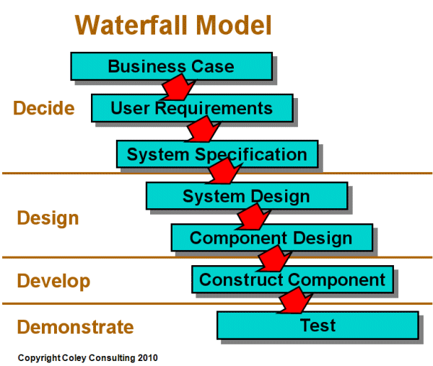

Slide 9
V-Model Testing
V-Model Testing - A framework to describe the software development lifecycle activities from requirements specification to maintenance. The V-model illustrates how testing activities can be integrated into each phase of the software development lifecycle.

Slide 10
V-Model Test Level
A group of test activities that are organized and managed together.
A test level is linked to the responsibilities in a project.
Examples of test levels are component test, integration test, system test and acceptance test

Slide 11
V-Model uses four levels of testing
Component testing – searching for defects in and verifies the functioning of software components (modules, programs, objects, classes, etc.)
Integration testing – The process of combining components or systems into a large assemblies.

Slide 12
V-Model uses four levels of testing
System testing – The process of testing an integrated system to verify that it meets specified requirements.
Acceptance testing – Validation testing with respect to user needs, requirements and business processes conducted to determine whether or not to accept the system.

Slide 13
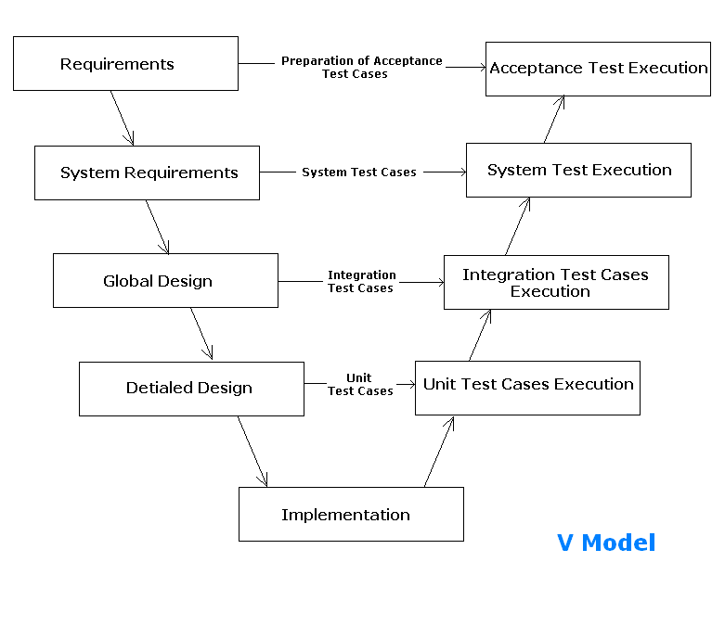

Slide 14
Commercial off-the-shelf software (COTS)
A software product that is developed for the general market, i.e. for a large number of customers, and that is delivered to many customers in identical format.
Purchaser may only perform integration testing and may be acceptance testing.

Slide 15
Commercial off-the-shelf software (COTS)
The acceptance testing can include both testing of system functions but also testing quality attributes such as performance and other non-functional tests.

Slide 16
Performance Testing
Performance testing – The degree to which a system or component accomplishes its designated functions within given constraints regarding processing time and throughput rate.
The process of testing to determine the performance of a software product.

Slide 17
Performance Testing Tools
Load generation can simulate either multiple users or high volumes of input data.
During execution, response time measurements are taken from selected transactions and these are logged.
Performance testing provides test logs and graphs of load against response times.

Slide 18
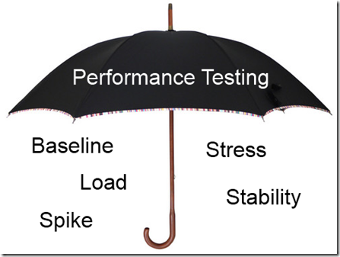

Performance – Stress Testing

Slide 19
Load Testing
A type of performance testing conducted to evaluate the behavior of a component or system with increasing load, e.g., numbers of parallel users and/or numbers of transactions, to determine what load can be handled by the component or system.

Slide 20
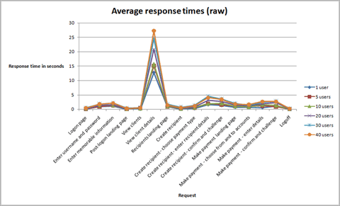

Slide 21
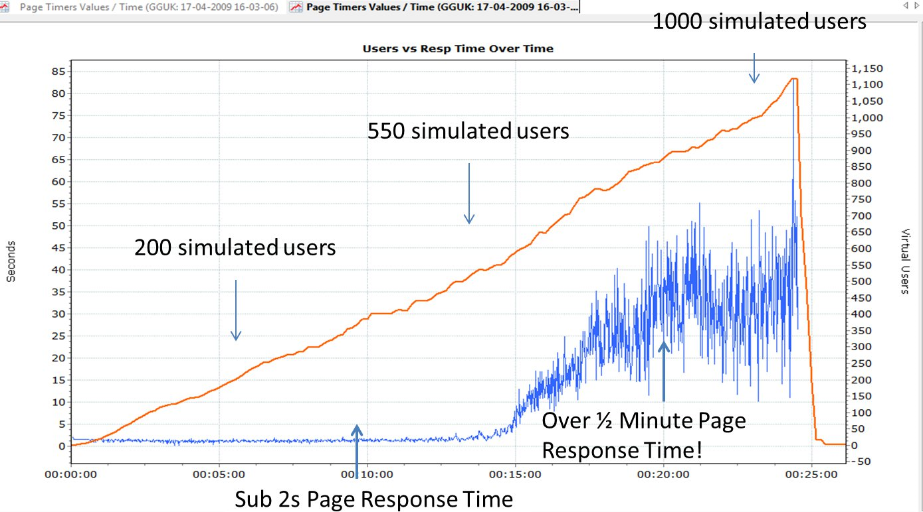

Slide 22
Stress Testing
A type of performance testing conducted to evaluate a system or component at or beyond the limits of its anticipated or specified work loads, or with reduced availability of resources such as access to memory or servers.

Slide 23
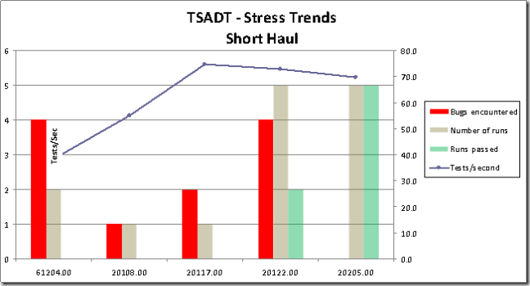

Slide 24
Capability Maturity Model (CMM)
A first level staged framework that describes the key elements of an effective software process.
The Capability Maturity Model covers best-practices for planning, engineering and managing software development and maintenance.

Slide 25
Capability Maturity Model Integration (CMMi)
A framework that describes the key elements of an effective product development and maintenance process.
The Capability Maturity Model Integration covers best-practices for planning, engineering and managing product development and maintenance.

Slide 26
Iterative life cycles
Iterative development model – A development lifecycle where a project is broken into a usually large number of iterations. An iteration is a complete development loop resulting in a release (internal or external) of an executable product, a subset of final product and grows into final product.

Slide 27
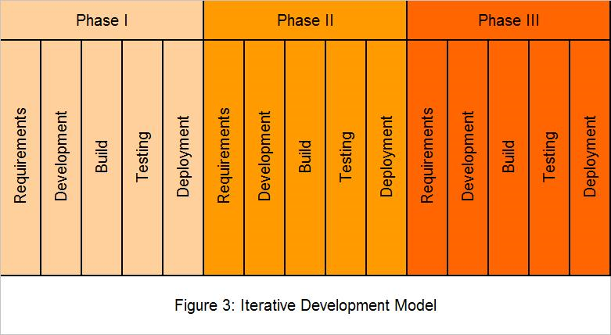

Slide 28
Incremental Development Model
A development lifecycle where a project is broken into a series of incensements, each of which delivers a portion of the functionality in the overall project requirements.
Requirements are prioritized and delivered in priority order in the appropriate increments.

Slide 29
Incremental Testing
Testing where components or systems are integrated and tested one or some at a time, until all the components or systems are integrated and tested.

Slide 30
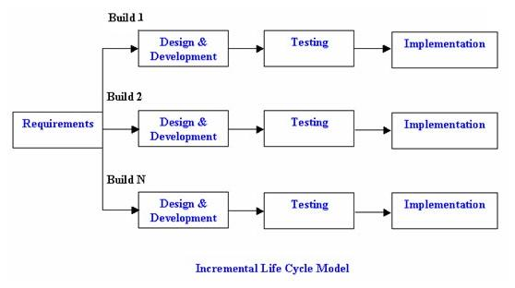

Slide 31
Rapid Application Development - RAD
Rapid Application Development is formally a parallel development of functions and subsequent integration.
This methodology allows early validation of technology risks and a rapid response to changing customer requirements.

Slide 32
Rapid Application Development - RAD
RAD provides early visibility of the product to the customer.
Customer can provide feedback on the design and can decide, based on the existing functionality, whether to proceed with the development, what functionality to include in the next delivery cycle or stop the project.

Slide 33
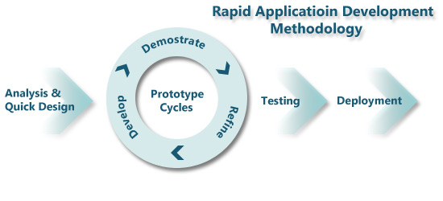

Slide 34
Agile Software Development
A group of software development methodologies based on iterative incremental development, where requirements and solutions evolve through collaboration between self-organizing cross-functional teams.

Slide 35
Agile Teams
Most agile teams use Scrum, a management framework for iterative incremental development projects.
Agile teams consist of 5-9 people

Slide 36
Agile Manifesto a Statement of Value
Individuals & Interactions
Working Software
Customer collaboration
Responding to Change
Process & Tools
Comprehensive documentation
Contract negotiations
Following a Plan

Slide 37
Test Driven Development
A way of developing software where the test cases are developed, and often automated, before the software is developed to run those test cases.

Slide 38
Agile Testing
Testing practice for a project using agile methodologies, such as extreme programming (XP), treating development as the customer of testing and emphasizing the test-first design paradigm.

Slide 39
Benefits of Agile Testing
Focus on working software and good quality
Test driven development
Accessibility of business stakeholders to help testers
Self-organizing teams
Simplicity of design that should be easier to test

Slide 40
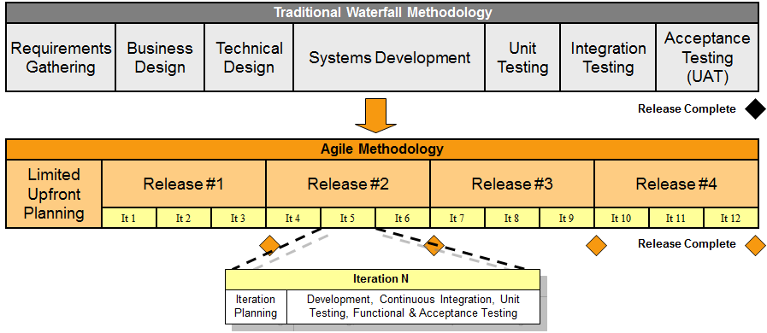

Slide 41
Test driven development
Test driven development is a way of developing software where the test cases are developed, and often automated, before the software is developed to run those test cases.

Slide 42
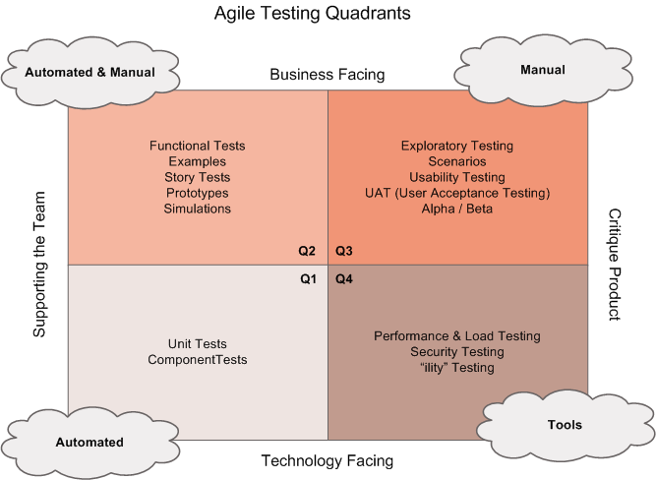

Slide 43
Extreme Programming (XP)
A software engineering methodology used within agile software development whereby core practices are programming in pairs, doing extensive code review, unit testing of all code, and simplicity and clarity in code.

Slide 44
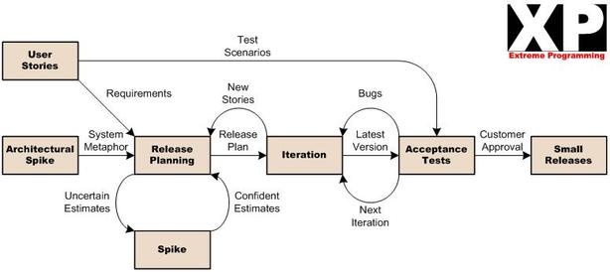

Slide 45
SCRUM
Scrum is an iterative incremental framework for managing projects commonly used with agile software development.
Changes are incorporated continuously into the software build.

Slide 46
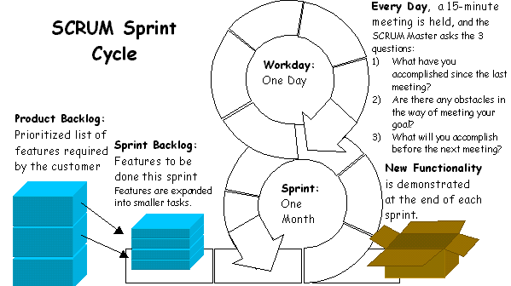

Slide 47
2.2 Test Levels
A group of test activities are organized and managed together.
A test level is linked to the responsibilities in a project.
Component Test,
Integration Test
System Test and
Acceptance Test

Slide 48
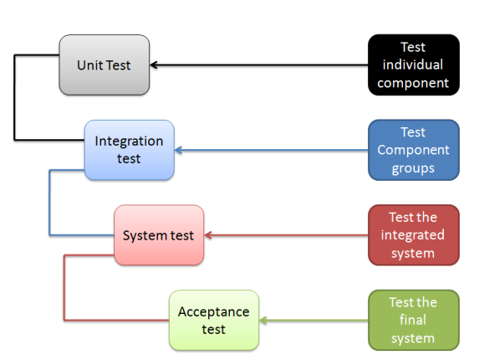
Test Levels

Slide 49
Testing Best Practices
Measurable effectiveness & efficiency
The test basis
The item build – test object
The typical defects and failures
Applicable requirements for test harnesses
Approaches we intend to use

Slide 50
Efficiency and Efficiency Testing
The capability of the software product to provide appropriate performance, relative to the amount of resources used under state conditions. (ISO)
The process of testing to determine the efficiency of a software product.

Slide 51
Component Testing (Unit or Module)
A single procedure
A function
A body of code that implements a single function
Source code that fits on one page
Code done in 4-40 hours – 300 lines
The smallest body of code that can be compiled and executed by itself

Slide 52
Stubs and Drivers
Component testing may be done in isolation from the rest of the system depending on the context of the development life cycle and the system.
Stubs and drivers are used to replace the missing software and simulates interface between software components

Slide 53
Stub
A skeletal or special-purpose implementation of a software component, used to develop or test a component that calls or is otherwise dependent on it. It replaces a called component.

Slide 54
Driver (Test Driver)
A software component or test tool that replaces a component that takes care of the control and/or the calling of a component or system.

Slide 55
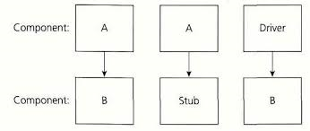
Stubs and Drivers

Slide 56
Robustness Testing
Robustness: The degree to which a component or system can function correctly in the presence of invalid inputs or stressful environmental conditions
Testing to determine the robustness of the software product
Error or fault tolerance (ISO)

Slide 57
Component Testing
Include testing of functionality and specific non-functional characteristics such as resource-behavior (e.g. memory leaks), performance or robustness testing, as well as structural testing (e.g. decision coverage)

Slide 58
Test Driven Development
A way of developing software where the test cases are developed and often automated, before the software is developed to run those test case
Extreme programming (XP), prepares and automates test cases before coding

Slide 59
Integration Testing
The process of combining components or systems into larger assemblies
Testing performed to expose defects in the interfaces and in the interactions between integrated components or systems

Slide 60
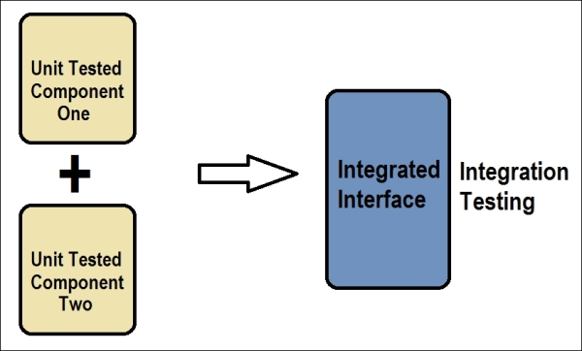
Component to Integration Testing

Slide 61
System Integration Testing
Testing the integration of systems and packages; testing interfaces to external organizations (e.g. Electronic Data Interchange, Internet)
Integration testing may be carried out by the developers, but can be done by a separate team of specialist integration testers

Slide 62
System Testing
The process of testing an integrated system to verify that it meets specified requirements
Includes tests based on risk analysis reports, system, functional, or software requirements specifications, business processes, use cases, and interactions with the operating system and system resources

Slide 63
System Testing
System testing is most often the final test on behalf of development to verify that the system to be delivered meets the specification and its purpose may be to find as many defects as possible.

Slide 64
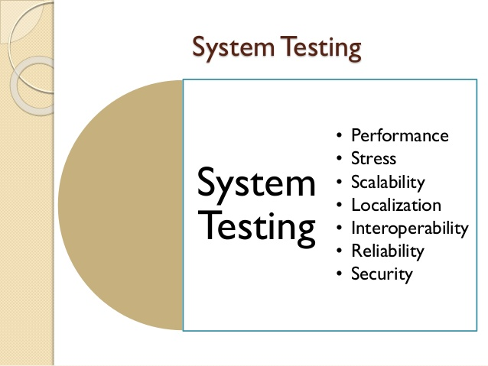

Slide 65
System Testing
System testing should investigate both functional and non-functional requirements of the system.

Slide 66
System Testing
Functional Requirement – A requirement that specifies a function that a component or system must perform
Non-Functional Requirement – A requirement that attributes to reliability, efficiency, usability, maintainability and probability

Slide 67
System Testing
System testing requires a controlled test environment including controlled software versions, testware and the test data
The test environment should be similar to the production environment in order to minimize the risk of environment-specific failures

Slide 68
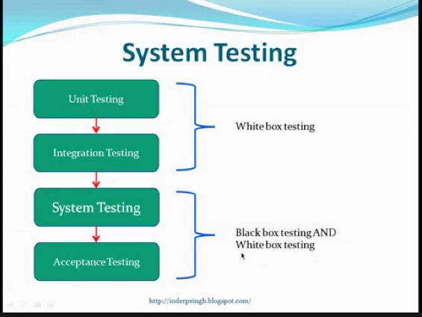

Slide 69
Acceptance Testing
Formal testing with respect to user need, requirements and business processes conducted to determine whether or not a system satisfies the acceptance criteria and to enable the user, customers or other authorized entity to determine whether or not to accept the system

Slide 70
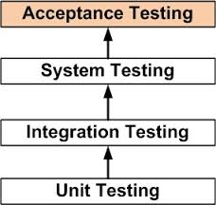

Slide 71


Slide 72
Alpha Testing
Simulated or actual operational testing by potential users/customers or an independent test team at the developers’ site, but outside the development organization. Alpha testing is often employed for off-the-shelf software as a form of internal acceptance testing.

Slide 73


Slide 74
Beta Testing
Operational testing by potential and/or existing users/customers at an external site not otherwise involved with the developers, to determine whether or not a component or system satisfies the user/customer needs and fits within the business processes. It is an external form of testing to acquire the feedback from the market

Slide 75
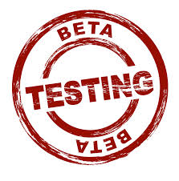
Beta Testing (Field Testing)

Slide 76
Test Types
A group of test activities aimed at testing a component or system focused on a specified test objective, i.e. functional test, usability test, regression test etc. A test type may take place on one or more test levels or test plans.

Slide 77
Functional Testing
Testing based on analysis of the specifications of the functionality of a component or system
Functional testing is also referred to as black-box testing (specification based testing)
The process of testing to determine the functionality of a software product (ISO)

Slide 78
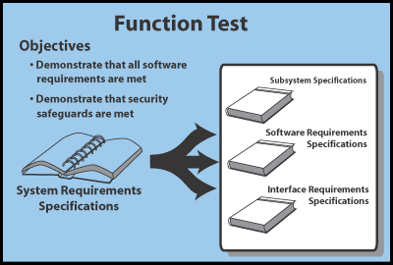

Slide 79
Functional Testing
Focused on suitability, interoperability testing, security, accuracy and compliance.
Interoperability testing determines the interoperability of a software product

Slide 80
Functional Testing
Security: Attributes of software products that bear on its ability to prevent unauthorized access, whether accidental or deliberate, to programs and data
Security Testing: Testing to determine the security of the software product

Slide 81


Security Testing

Slide 82
Non-Functional Testing
Non-functional testing is performed at all levels
Testing the attributes of a component or system that do not relate to functionality, e.g. reliability, efficiency, usability, maintainability and portability

Slide 83
Non-Functionality Testing
Reliability Testing: The process of testing determine the reliability of a software product
The ability of the software product to perform its required functions under stated conditions for a specified period of time, or for a specified number of operations (robustness)

Slide 84
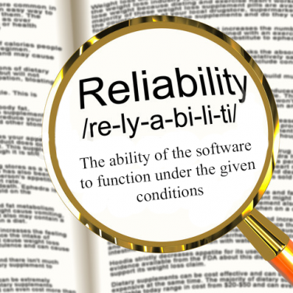

Slide 85
Non-Functionality Testing
Usability Testing: Testing to determine the extent to which the software product is understood, easy to learn, easy to operate and attractive to the users under specified conditions
The capability of the software to be understood, learned, used and attractive to user when used under specified conditions – easy to use

Slide 86
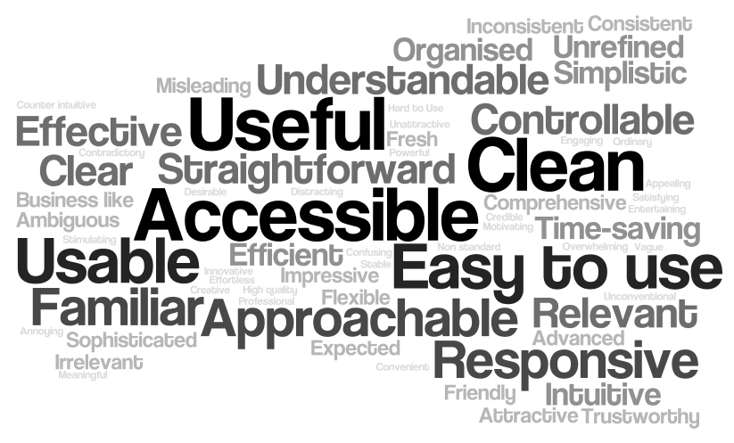

Slide 87
Non-Functional Testing
Efficiency Testing: The process of testing to determine the efficiency of a software product
The capability of the software product to provide appropriate performance, relative to the amount of resources used under stated conditions

Slide 88
Non-Functional Testing
Maintainability Testing: The process of testing to determine the maintainability of the software product
The ease with which a software product can be modified to meet new requirements, modified to make future maintenance easier, or adapted to changed environment

Slide 89
Non-Functional Testing
Portability Testing: The process of testing to determine the portability of a software product
The ease with which the software product can be transferred form one hardware or software environment to another

Slide 90
Structural Testing (White-Box)
Testing is based on an analysis of the internal structure of the component or system (code coverage)
Procedures to derive and/or select test cases based on an analysis of the internal structure of a component or system

Slide 91
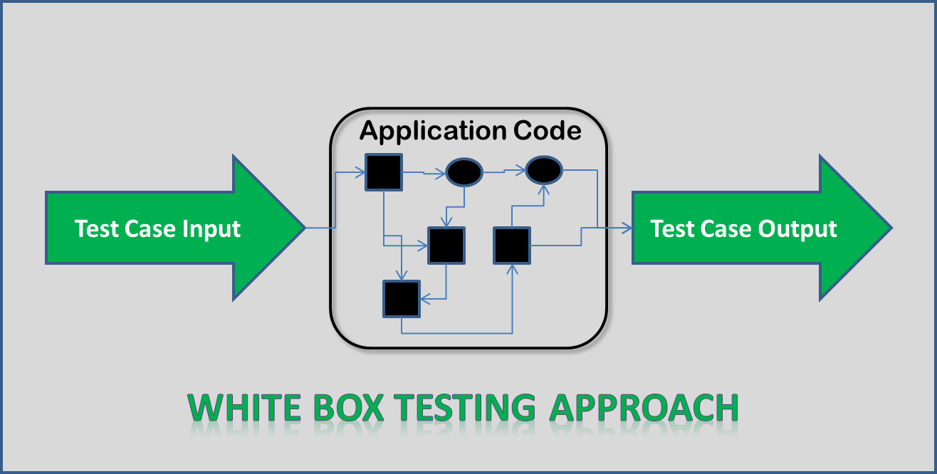

Slide 92
Black-Box Testing(specification based)
Procedure to derive and/or select test cases based on an analysis of the specification, either functional or on-functional, of a component or system without reference to its internal structure
Requirement based testing

Slide 93
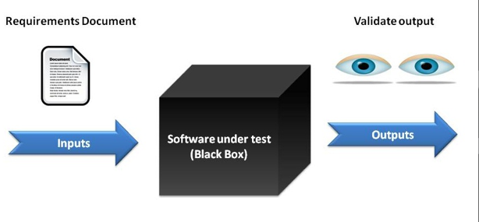
Black Box Testing

Slide 94
Confirmation Testing (Re-Testing)
Testing that runs test cases that failed the last tie they were run, in order to verify the success of corrective actions
It’s a verification of fixed issues
It needs to be executed in the same manner as it was initially executed

Slide 95
Regression Testing
Testing of a previously tested program following modification to ensure that defects have not been introduced or uncovered in unchanged areas of the software, as a result of the changes made. It is performed when the software or its environment is changed

Slide 96
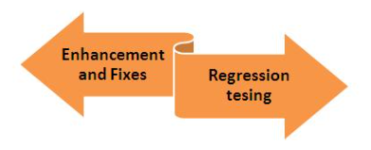
Regression Testing

Slide 97
2.4 Maintenance Testing
Testing the changes to an operational system or the impact of a changed environment to an operational system
Modifications from planned enhancement changes a minor release includes bug fixes or urgent emergency changes

Slide 98
Impact Analysis & Regression Testing
The assessment of change to the layers of development documentation, test documentation and components, in order to implement a given change to specified requirements

Slide 99
Triggers for Maintenance Testing
Planned modifications:
New function or enhance performance
Adaptive modifications – environmental changes (new hardware, software, system or legislation)
Corrections of defects

Slide 100
Ad-hoc Corrective Modifications
Ad-hoc corrective modifications are required for immediate solution (production issue)
Testing carried out informally; no formal test preparation takes place, no recognized test design technique is used, there are no expectations for results and arbitrariness guides the test execution activity

Slide 101
2. Testing Throughout the Software Life Cycle – Question 1
1 What are good practices for testing within the development life cycle?
a. Early test analysis and design.
b. Different test levels are defined with specified objectives.
c. Testers will start to get involved as soon as coding is done.
d. A and B above.

Slide 102
2. Testing Throughout the Software Life Cycle – Question 2
Which option best describes objectives for test levels with a life cycle model?
a. Objectives should be generic for any test level.
b. Objectives are the same for each test level.

Slide 103
2. Testing Throughout the Software Life Cycle – Question 2 – answers
c. The objectives of a test level don’t need to be defined in advance.
d. Each level has objectives specific to that level.

Slide 104
2. Testing Throughout the Software Life Cycle – Question 3
Which of the following is a test type?
a. Component testing
b. Functional testing
c. System testing
d. Acceptance testing

Slide 105
2. Testing Throughout the Software Life Cycle – Question 4
Which of the following is a non-functional quality characteristic?
a. Feasibility
b. Usability
c. Maintenance
d. Regression

Slide 106
Questions - 2. Testing Throughout the Software Life Cycle – Question 5
Which of these is a functional test?
a. Measuring response time on an on-line booking system.
b. Checking the effect of high volumes of traffic in a call-center system.

Slide 107
2. Testing Throughout the Software Life Cycle – Question 5 - answers
c. Checking the on-line bookings screen information and the database contents against the information on the letter to the customers.
d. Checking how easy the system is to use.

Slide 108
2. Testing Throughout the Software Life Cycle – Question 6
Which of the following is a true statement regarding the process of fixing emergency charges?
a. There is no time to test the change before it goes live, so only the best developers should do this work and should not involve testers as they slow down the process.

Slide 109
2. Testing Throughout the Software Life Cycle – Question 6 - answers
b. Just run the retest of the defect actually fixed.
c. Always run a full regression test of the whole system in case other parts of the whole system have been adversely affected.

Slide 110
2. Testing Throughout the Software Life Cycle – Question 6 - answers
d. Retest the changed area and then use risk assessment to decide on a reasonable subset of the whole regression test to run in case other parts of the system have been adversely affected.

Slide 111
2. Testing Throughout the Software Life Cycle – Question 7
A regression test:
a. Is only run once.
b. Will always be automated.
c. Will check unchanged areas of the software to see if they have been affected.
d. Will check changed area of the software to see if they have been affected.

Slide 112
2. Testing Throughout the Software Life Cycle – Question 8
Non-functional testing includes:
a. Testing to see where the system does not function correctly.
b. Testing the quality attributes of the system including reliability and usability.
c. Gaining user approval for the system

Slide 113
2. Testing Throughout the Software Life Cycle – Question 8 - answer
d. Testing a system feature using only the software required for that function.

Slide 114
2. Testing Throughout the Software Life Cycle – Question 9
Beta testing in:
a. Performed by customers as their own site.
b. Performed by customers at the software developer’s site.
c. Performed by an independent test team.

Slide 115
2. Testing Throughout the Software Life Cycle – Question 9
d. Useful to test software developed for a specific customer or user.

